Slide 1


Continuous Deployment
[ Advanced ]
Notes:
1

Slide 2
Topics for today!
1
Deep-dive: Types of Deployment
2
Different Strategies for deploying
3
Monitoring in CD with hands-on activity
4
Deployment Automation & Orchestration
5
CD Best practices & optimization
6
Release management & Approvals
Notes:
2

Slide 3
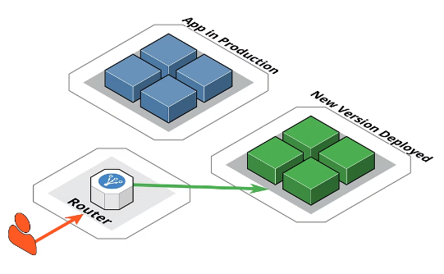
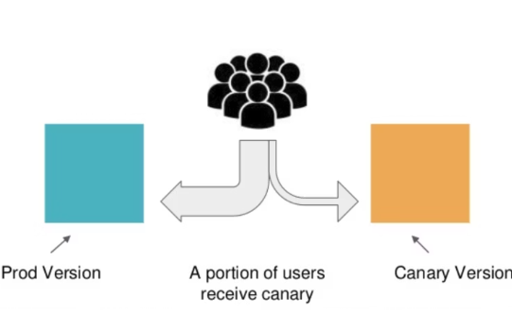
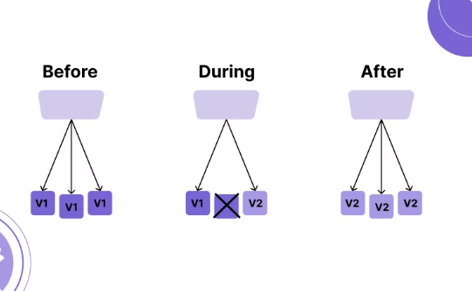
Types of Deployments
There are various deployment types that can be used according to the use-case, we will discuss the most common types.
Blue - Green Deployment
Canary Deployment
Rolling Deployment
Notes:
3

Slide 4
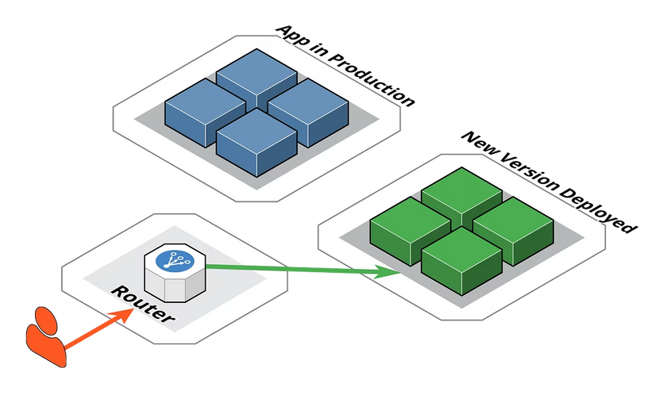



Blue/Green Deployment
Two Identical Environments
Maintain Blue (live) and Green (new version) environments.
Traffic Switch
After validation, switch traffic via DNS or Load Balancer.
Instant Rollback
If Green fails, revert DNS to point back to Blue.
Notes:
4

Slide 5

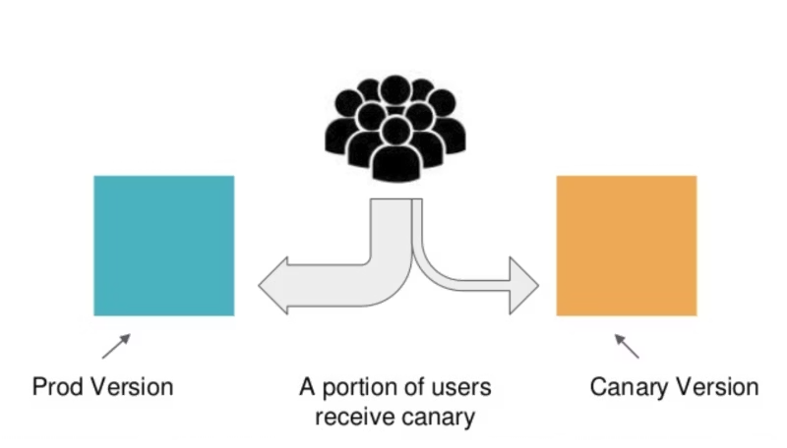
Canary Deployment
Release to Subset
New version is rolled out to a small subset of users (5%, 25%, 50%, 100%).
Monitor Performance
Behavior and performance are monitored at each stage.
Gradual Expansion
If stable, the rollout continues; else, it can be halted or rolled back.
Notes:
5

Slide 6

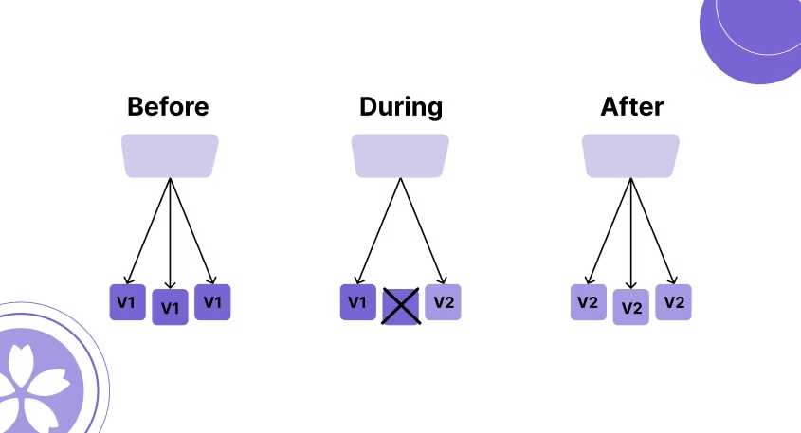
Rolling Deployment
1
Replace Instances
Replace old version instances one at a time with new ones.
2
Traffic Management
Balancer keeps sending traffic to healthy nodes.
3
Cost-effective
Rollback is slower, as older versions are already terminated but saves infrastructure cost.
Notes:
6

Slide 7
Comparison: Deployment types
Feature
Blue/Green
Canary
Rolling
Downtime
None
None
Minimal
Rollback Speed
Very Easy
Moderate
Moderate
Complexity
Moderate
High
Low
Cost
Higher infra
Moderate
Low
Risk mitigation
High
Very high
Medium
Infra Requirement
2 Environments
Feature routing
Same environments
Notes:
7

Slide 8
Strategy Design for Deployment
Scenario:
  You're working as a DevOps engineer for an e-commerce company.
  They’re launching a new homepage redesign expected to increase conversion.
Task:
  Design a deployment strategy using one of the three methods (Blue/Green, Canary, Rolling).
  Make sure to include:
Approach
Infrastructure needs
Monitoring steps
Rollback plan
Notes:
8

Slide 9
A Sample Solution!
1
Approach
Blue/Green Deployment
2
Infrastructure Setup
Blue Env: https://www.shop.com (current live)
Green Env: https://green.shop.com (new deployment)
Load Balancer/DNS controls traffic switching
3
Monitoring
Cloud provider (AWS CloudWatch) for errors logs
Prometheus + Grafana for real-time metrics
User feedback
4
Rollback plans
Instant revert via DNS switch to Blue.
Notes:
9

Slide 10



Hands-on: Blue/Green Deployment
Create Two App Versions [Clone from here]
Blue app (port 5000) and Green app (port 5001) using Flask.
Test Green Version
Verify new version works before switching traffic.
Switch Traffic
Redirect users from Blue to Green after validation.
Notes:
10

Slide 11

Monitoring in Continuous Deployment
Prometheus
Grafana
Pull-based metrics collection tool that stores data in a time-series database.
Visualization and alerting tool for creating real-time dashboards.
  Track app usage
  Visualize metrics
  Monitor resource usage
  Create dashboards
  Set up alerts
  Set up alerts
ELK Stack
Centralized log management with Elasticsearch, Logstash, and Kibana.
  Centralize logs
  Search errors
  Analyze activity
Notes:
11

Slide 12
Deployment Automation & Orchestration
What is Orchestration?
Orchestration is like having an automated assistant that:
  Deploys your app for you—no manual steps required.
  Keeps it running—restarts it if something goes wrong.
  Adjusts scale—adds or removes instances based on user demand.
Without orchestration, you'd be stuck doing all of this manually.
Common Orchestration Tools
Kubernetes
Terraform
Spinnaker
Kubernetes is a platform that takes care of deploying, managing, and scaling applications automatically.
Ex: If an app fails, Kubernetes restarts it on its own.
Terraform uses code to define and manage infrastructure like servers, networks, and storage.
Spinnaker is a deployment tool designed for managing applications across multiple cloud providers.
Ex: If you need 30 different remote servers, you write a configuration file, and Terraform sets it up for you.
Ex: When your application is dependent on specific service from >1 cloud provider. (AWS + GCP)
Notes:
13

Slide 13
Why use orchestration for deployment automation when we already have CI/CD pipeline?
Notes:
14

Slide 14
Key Differences
Feature
CI/CD Pipeline
Orchestration
Main Purpose
Automate building & deploying code
Automate running & managing apps
Scaling
Manual
Auto-scales up/down
Self-Healing
Crashes need manual fix
Auto-restarts failed apps
Infrastructure
Just deploys code (needs servers set up)
Creates & manages servers (IaC)
Best For
Fast code releases
Reliable, large-scale apps
Notes:
15

Slide 15






CD Best Practices
Security Scans
Add security checks before deployment
Approval Gates
Add manual or automated approvals
Small, Frequent Deployments
Deploy smaller updates more often
Notes:
16

Slide 16
Release Management & Approvals
Why Approvals Matter ?
In production or regulated environments, direct deployments are risky.
Approvals help to:
  Catch mistakes before they reach users.
  Ensure compliance with policies or external regulations.
Types of Approvals:
1
Manual
Involves manual intervention to review & approve the deployment before they proceed to next stage.
2
Automated
Use predefined checks & tests to validate deployment before moving to the next stage.
3
Governance in CD
Governance ensures that deployments adhere to organizational policies & regulatory standards.
Notes:
17

Slide 17
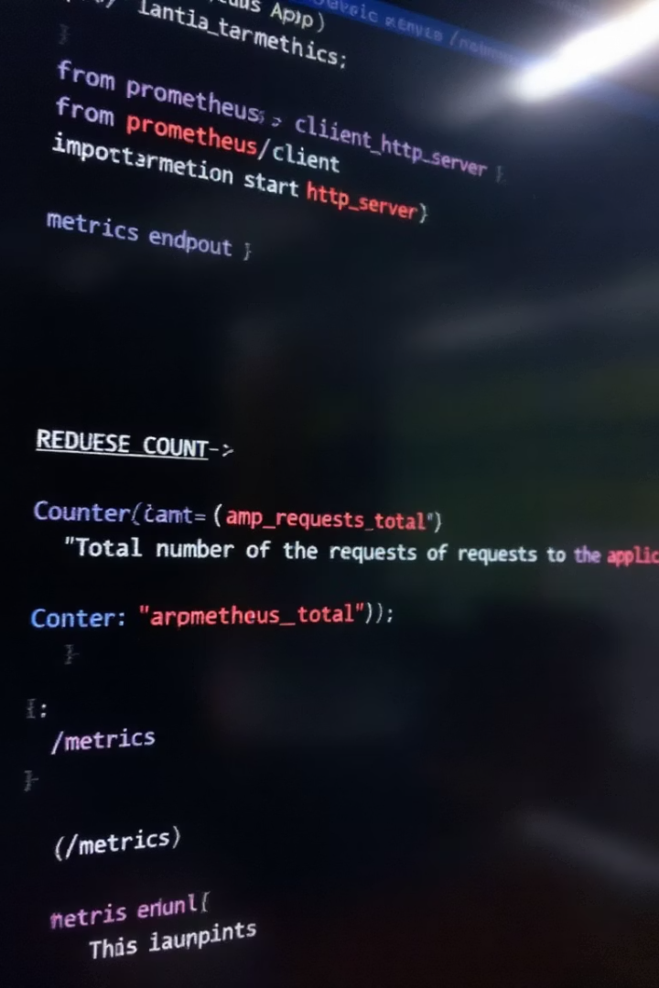




Add monitoring to Flask App for blue/green deployment
Add /metrics Endpoint
Implement Prometheus metrics in both Blue and Green apps.
Verify Metrics Manually
Check metrics endpoints to confirm they're working.
Set Up Prometheus
Configure Prometheus to scrape metrics from both apps.
View in Prometheus UI
Monitor request counts and other metrics in real-time.
Notes:
12

Slide 18
Completed the CI/CD phase … Achieved a milestone!
In the upcoming sessions, we’ll begin exploring essential DevOps tools and technologies that streamline the software development process and enhance overall development quality.
Notes:
18

